Slide 1

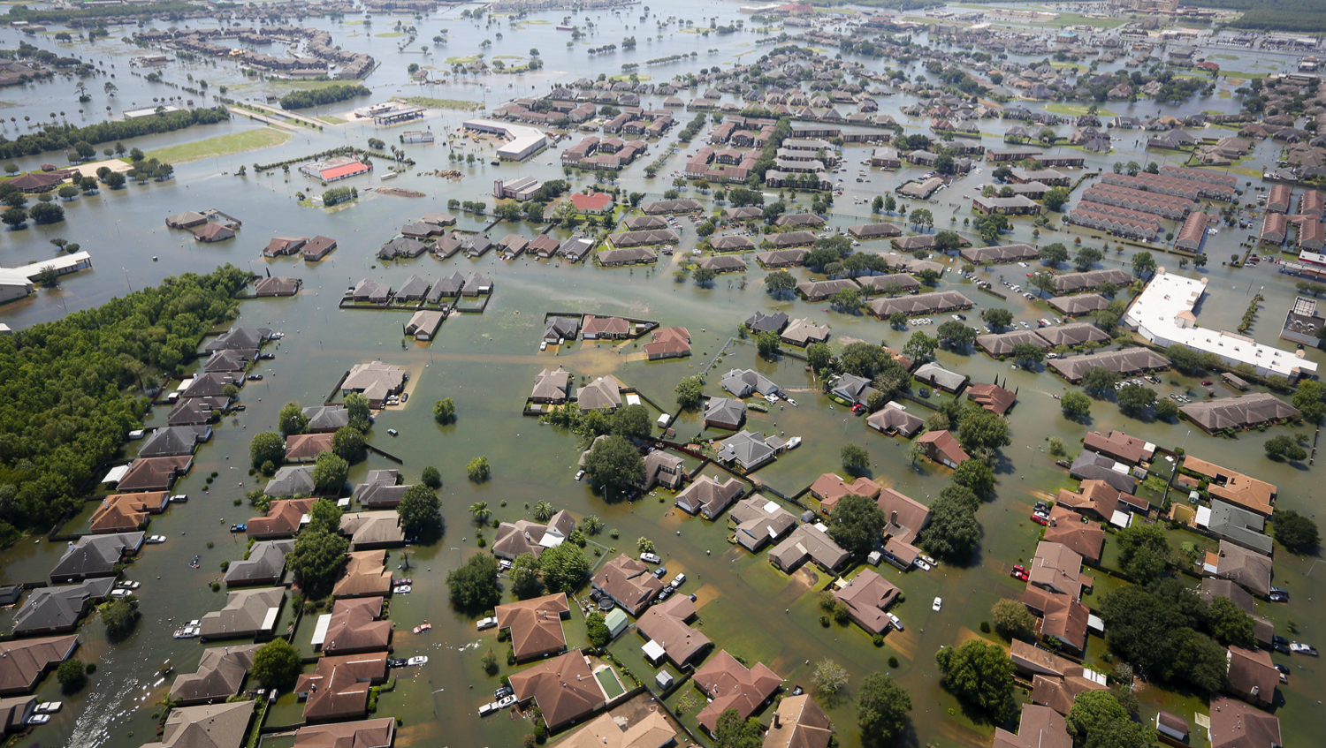
DSI Project 5: NLT Project
Post-Disaster Damage Assessment Tools
Sade Ekulona, Nick Minaie, Jeremy Opacich, Andrew Picart
DSI-8, August 2019

Slide 2

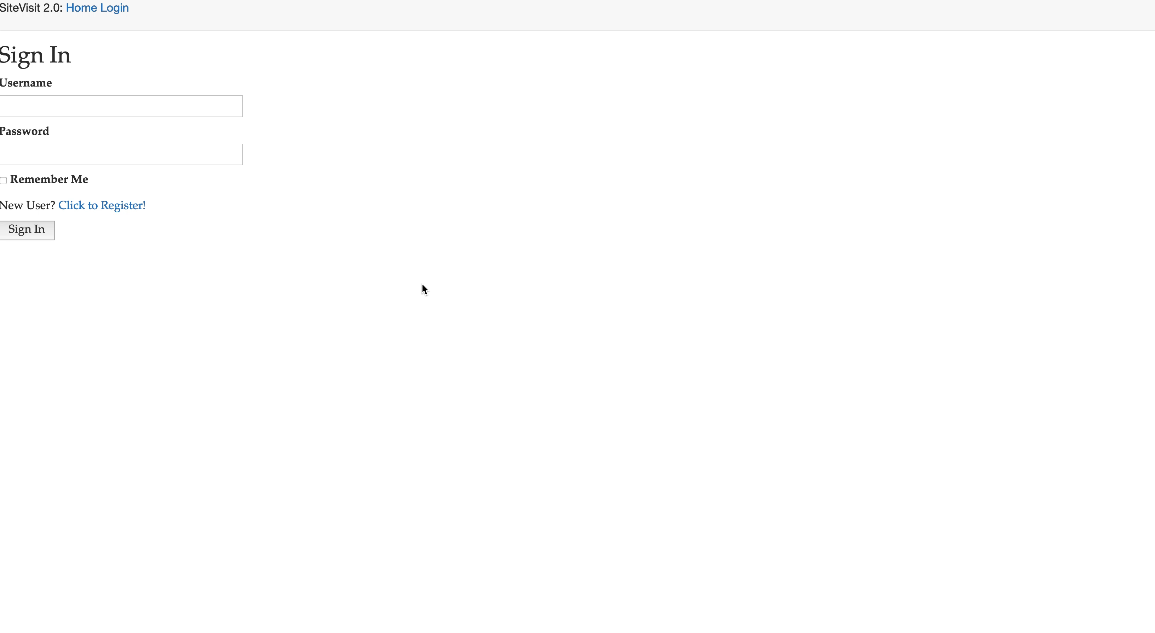
Demo of the Web-PDA

